Slide 1



THE African Peer Review Mechanism (APRM) Sensitisation project in nambia (ASPIN)
What is parliament’s role?
19 April 2018
National Assembly, Windhoek, Namibia
Steven.Gruzd@wits.ac.za
@rhymeswbruised
Swedish Residence, Pretoria
Steven Gruzd (@rhymeswbruised)
27 February 2018

Slide 2
OUTLINE
Introduction to APRM
Roles that national MPs have played/could potentially play in the APRM: Providing oversight, enhancing accountability, and promoting best practices and peer learning
Ideas for future parliamentary engagement in Namibia with the APRM

Slide 3


APRM in a nutshell
Africa’s voluntary governance review and promotion tool established in 2003, grew out of NEPAD
Belief that dialogue, peer pressure, diplomacy & civil society involvement can catalyse reform
Measures adherence to African & global standards in 4 thematic areas, comprehensive, based on questionnaire
“Technically competent, credible, and free of political manipulation”
Set up institutions at national and continental level
Self-assessment, country review mission, peer review
Develop, fund, implement and report on NPoA
37/55 African states, 21+2 reviewed

Slide 5
APRM Status in 37 Member States
CRR not published
1st CRR published
Ghana (2005)
Rwanda (2005)
Kenya (2006, 2018)
Algeria (2007)
South Africa (2007)
Burkina Faso (2008)
Benin (2008)
Nigeria (2009)
Uganda (2009)
Mali (2009)
Mozambique (2009)
Lesotho (2010)
Mauritius (2010)
Ethiopia (2011)
Sierra Leone (2012)
Zambia (2013)
Tanzania (2013)
Djibouti (2007, CRM 2015)
Chad (2013, CRM 2017)
Senegal (2004, CRM 2017)
Sudan 2006, (2018)
Uganda 2 (CRM 2017, 2018)
New or slow
Angola (2004)
Cameroon (2004)
Congo-B (2003)
Cote d’Ivoire (2015)
Egypt (2004)
Equatorial Guinea (2014)
Gabon (2003)
The Gambia (2018)
Liberia (2011, CRM 2017)
Malawi (2004)
Mauritania (2008)
Namibia (2017)
Niger (2012)
S. Tome & Principe (2007)
Togo (2008)
Tunisia (2013)
Notes:
5

Slide 6
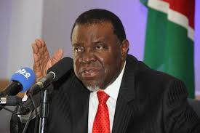
SONA, 11 April 2018
President Hage Geingob's State of the Nation (SONA) speech: "Namibia is now a full member of the African Peer Review Mechanism, a process that holds through peer review great potential for our political and economic governance processes. Civil society, a critical part of the APRM has already commenced discussions, and the National Planning Commission, as the lead agency shall be mobilised to start implementing a programme of action. Our work in the APRM reinforces the urgency with which we should deal with corruption and poor governance in Africa."

Slide 7
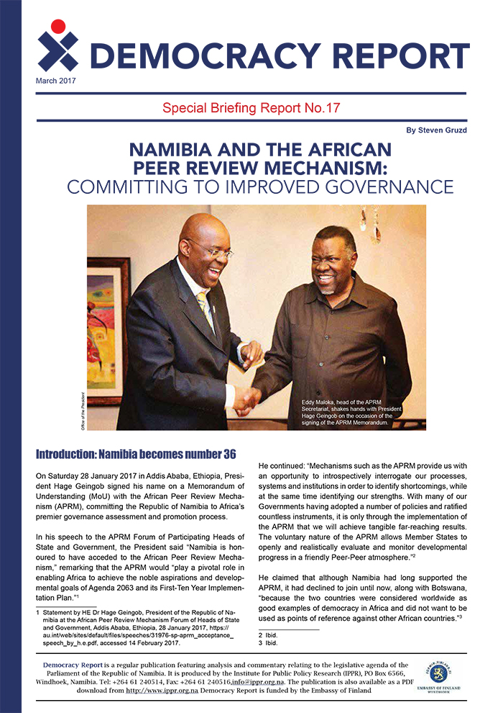
APRM Sensitisation project in Namibia
(ASPIN)
Work with APRM Secretariat, IPPR and PAP (OSISA & FES)
Scoping visit 19-20 Feb 2018
APRM Working Group formed
Training workshop, 17-18 April
Parliament workshop, 19 April
Working Group Meeting
Help develop written submission
Validation
Rollout and media strategy

Slide 8
roleS for NATIONAL parliaments
An important but neglected stakeholder - subject & object
Not much official guidance
Should be consulted by Country Review Mission (Base Document paragraph 19, 2003)
  “In Stage Two, the Review Team will visit the country concerned where its priority order of business will be to carry out the widest possible range of consultations with the Government, officials, political parties, parliamentarians and representatives of civil society organizations (including the media, academia, trade unions, business, professional bodies).”
Should participate in National Governing Council/Commission (Supplementary Guidelines, 2007)
  “Composition of the National Structure: Both state and non-state actors participate in the process. This includes some representatives of key line ministries, civil society, parliament, media, private sector, youth, women groups, disabled, marginalised groups, rural populations, etc. The National Commission should offer microcosm of the nation. Where possible, it should be chaired by a non-state functionary.”

Slide 9
Entry points for parliament
Accession
Ratification
NGC membership
Sensitisation and popularisation
Research and information provision
Public hearings, sub-committees
Report writing
NPoA formulation
NPoA implementation
NPoA monitoring and evaluation

Slide 10
Parliament’s APRM record
Role has so far been largely ceremonial, meeting dignitaries, participation in workshops, some MPs on NGC (but rare)
Relatively little input, influence, and role in ensuring oversight, monitoring and accountability
Parliamentary opposition parties have often ignored, criticised or boycotted APRM process
Parliament has not taken ownership of the APRM

Slide 11
Parliament and APRM in South Africa
  SA was the exception
  No initial plan to include parliament – changed after public pressure. Parliament took the initiative
  Oct 2005 – parliament established four joint ad hoc committees, with ruling party and opposition MPs, on four APRM Thematic Areas (DPG, EGM, CG & SED), plus joint coordinating committee
  Committees held nationwide hearings, open to the public, adverts and public notices - generated written submissions
  Technical Research Institutions used parliamentary submissions as data for the Country Self-Assessment Report
  Parliamentary report was eventually folded into CSAR
  Poor lesson learning – no other country emulated this model

Slide 12
Strengths of Parliament in SA Process
Gathered valuable material through submissions and hearings – especially for TRIs’ use
Popularised APRM
Newspaper advertisements
Examined standards & codes
Opportunity for all parties, both NA & NCOP to be involved
Active participation in research seminars and validation
Transparent use of website

Slide 13
WEAKNESSES
Time and timing – rush, December, local elections, curtailment
Confusion over Parliament vs NGC processes
Low awareness
Low responsiveness
Language – only held hearings in English
Report reflected insufficiently on parliament’s oversight role, own strengths & weaknesses, & performance
Trying to get a good mark for SA?

Slide 14
Parliament and the aprm
Work by UNECA to involve & engage MPs (Bagamoyo ’08, Addis 2011)
Parliaments must insert themselves into APRM
But to do so … MPs need to be informed, value adders rather than passive observers
This means holding APRM meetings with constituents as much as it does holding ad hoc/APRM committee meetings
What has your national parliament done?

Slide 15
PRACTICAL RECOMMENDATIONS
Play an active part in APRM – be informed
Be open to approaches from the public & CSOs
Examine parliament’s own role and record
Budget for peer review
Integrate efforts with NGC
Encourage political parties to take APRM seriously, make submissions
Share experiences
Get involved in formulating, overseeing implementation of NPoA
Form standing committees for APRM monitoring

Slide 16
Thank you!
Steven.Gruzd@wits.ac.za
@rhymeswbruised
#ReviveAPRM on Facebook

