Slide 1
Youth PARTICIPATION IN THE APRM
Luanda Mpungose
Luanda.Mpungose@wits.ac.za
ASPIN Workshop
18 April 2018

Slide 2
History of youth participation : aprm
2016: APRM was not a youth friendly space
2017: There were younger people being recruited at the continental secretariat
2018: APRM Continental Secretariat has demonstrated some transformation
young people have gone on review missions
Internship opportunities for young people

Slide 3
Young people in the aprm review mission
(Image of Uganda mission to be added)

Slide 4
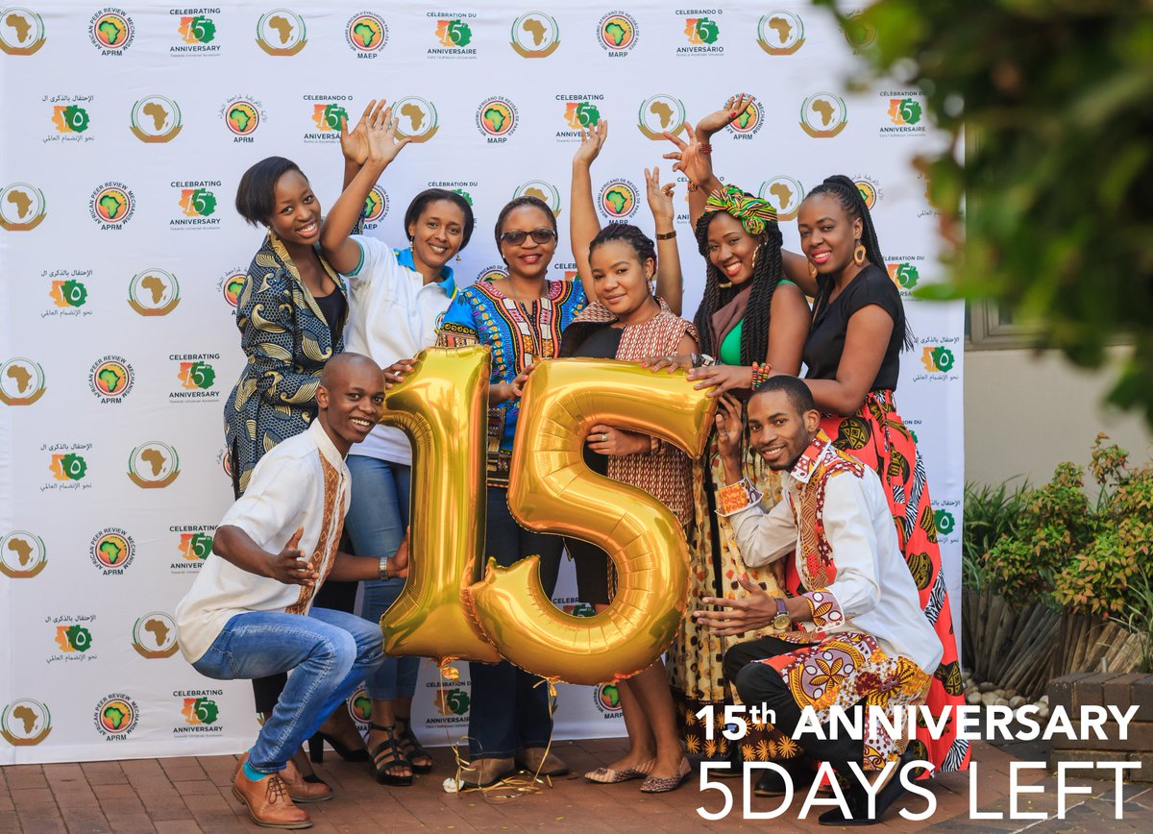
Young people at the aprm secretariat

Slide 5
Importance of youth in the aprm
Africa is a young continent with 70% of its population below the age of 30
Bad governance affects young people
To enhance youth representation in African governance
Harnessing the demographic dividend

Slide 6
Kenya youth working group
Established in September 2015
Group of young people who have mobilised themselves to become part of the APRM process
Operating with minimal resources
They use social media to engage on governance issues

Slide 7
Kenya youth working group

Slide 8
Looking forward
Governments should not be dismissive of its youth constituent
Youth have a responsibility to engage government constructively
Including more young people in Country Review Missions
Young people in National Governing Structures
Build capacity within youth on the APRM eg. APRM-SAIIA Governance Topic Talk

Slide 9
Thank you!
Luanda.mpungose@wits.ac.za
#ReviveAPRM

