Slide 1
MALAWI APRM POPULAR SENSITISATION PROJECT (MAPS)
Launch workshop, 24 July 2024
Ufulu Gardens Hotel, Lilongwe, Malawi
Steven Gruzd

Slide 2
AFRICAN PEER REVIEW MECHANISM (APRM)
Africa’s good governance promotion and self-monitoring tool
Aims to promote good governance, predicated on regular participation, transparency, accountability, inclusiveness and openness
Malawi acceded in 2004
CSOs worked on this submission 2022-2024

Slide 3
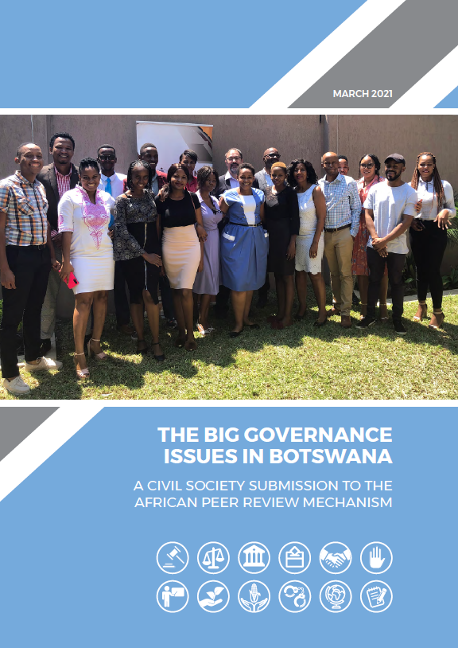
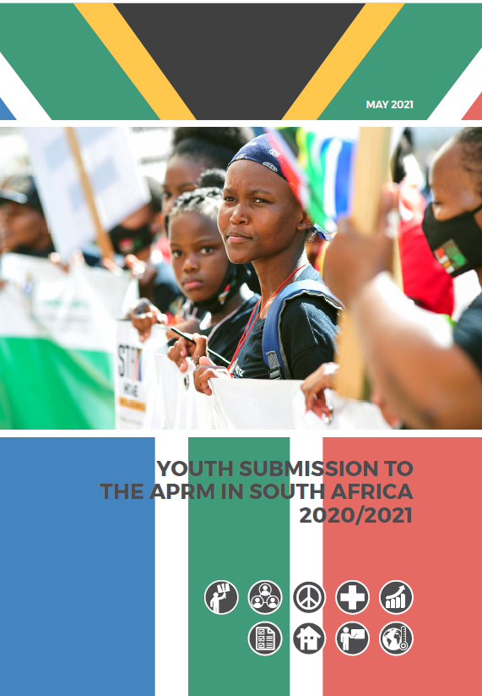
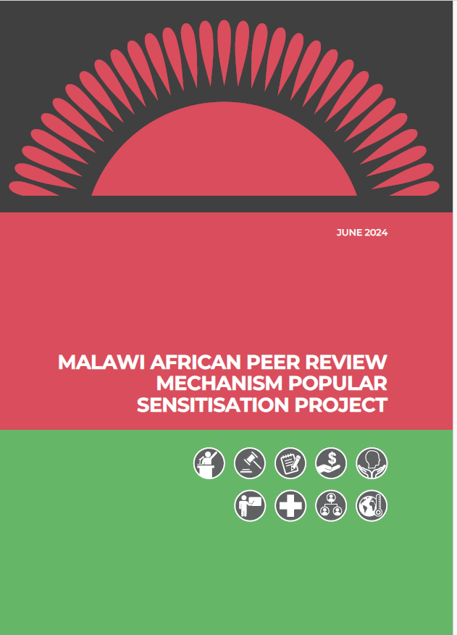
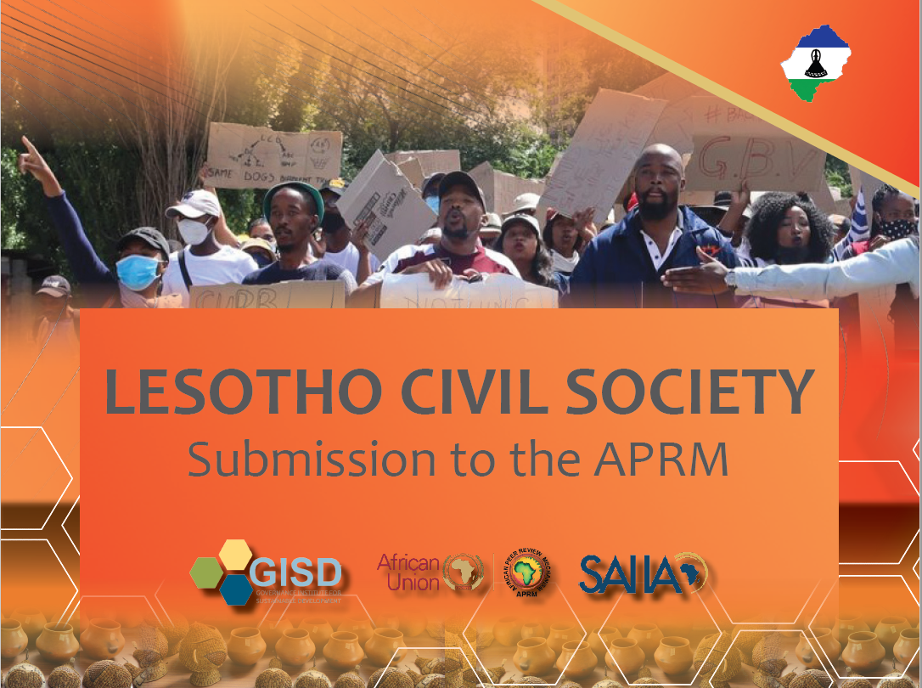

Slide 4
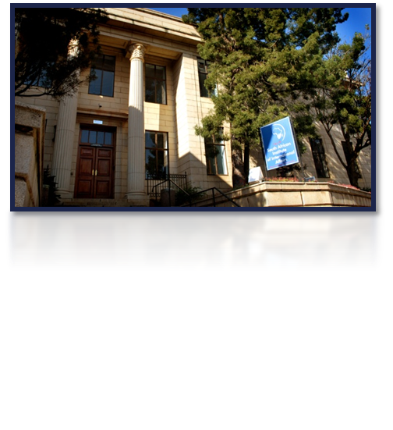
SAIIA and THE APRM
Since 1934, independent, non-governmental think tank on international affairs. Turned 90 in 2024
5 major programmes: AGDP, ERIP, CNRP, Futures, Youth
Worked consistently on APRM since 2002
Research, analysis, training, consulting to the Secretariat
Sensitised CSOs in early countries, worked on questionnaire revision, bottlenecks to development, expanded mandate, analysis of reports, media
Developed CSO submissions in Namibia, Botswana, SA, Zimbabwe, Lesotho & Malawi 2018-24

Slide 5
APRM in a nutshell
Africa’s voluntary governance review and promotion tool established in 2003, grew out of NEPAD
Belief that dialogue, peer pressure, diplomacy & civil society involvement can catalyse and support reform
Measures adherence to African & global standards in 5 thematic areas, comprehensive, based on questionnaire
“Technically competent, credible, and free of political manipulation”
Set up institutions at national and continental level
Self-assessment, country review mission, peer review
Develop, fund, implement and report on NPoA
44/55 African states, 26+6+6 reviewed

Slide 6
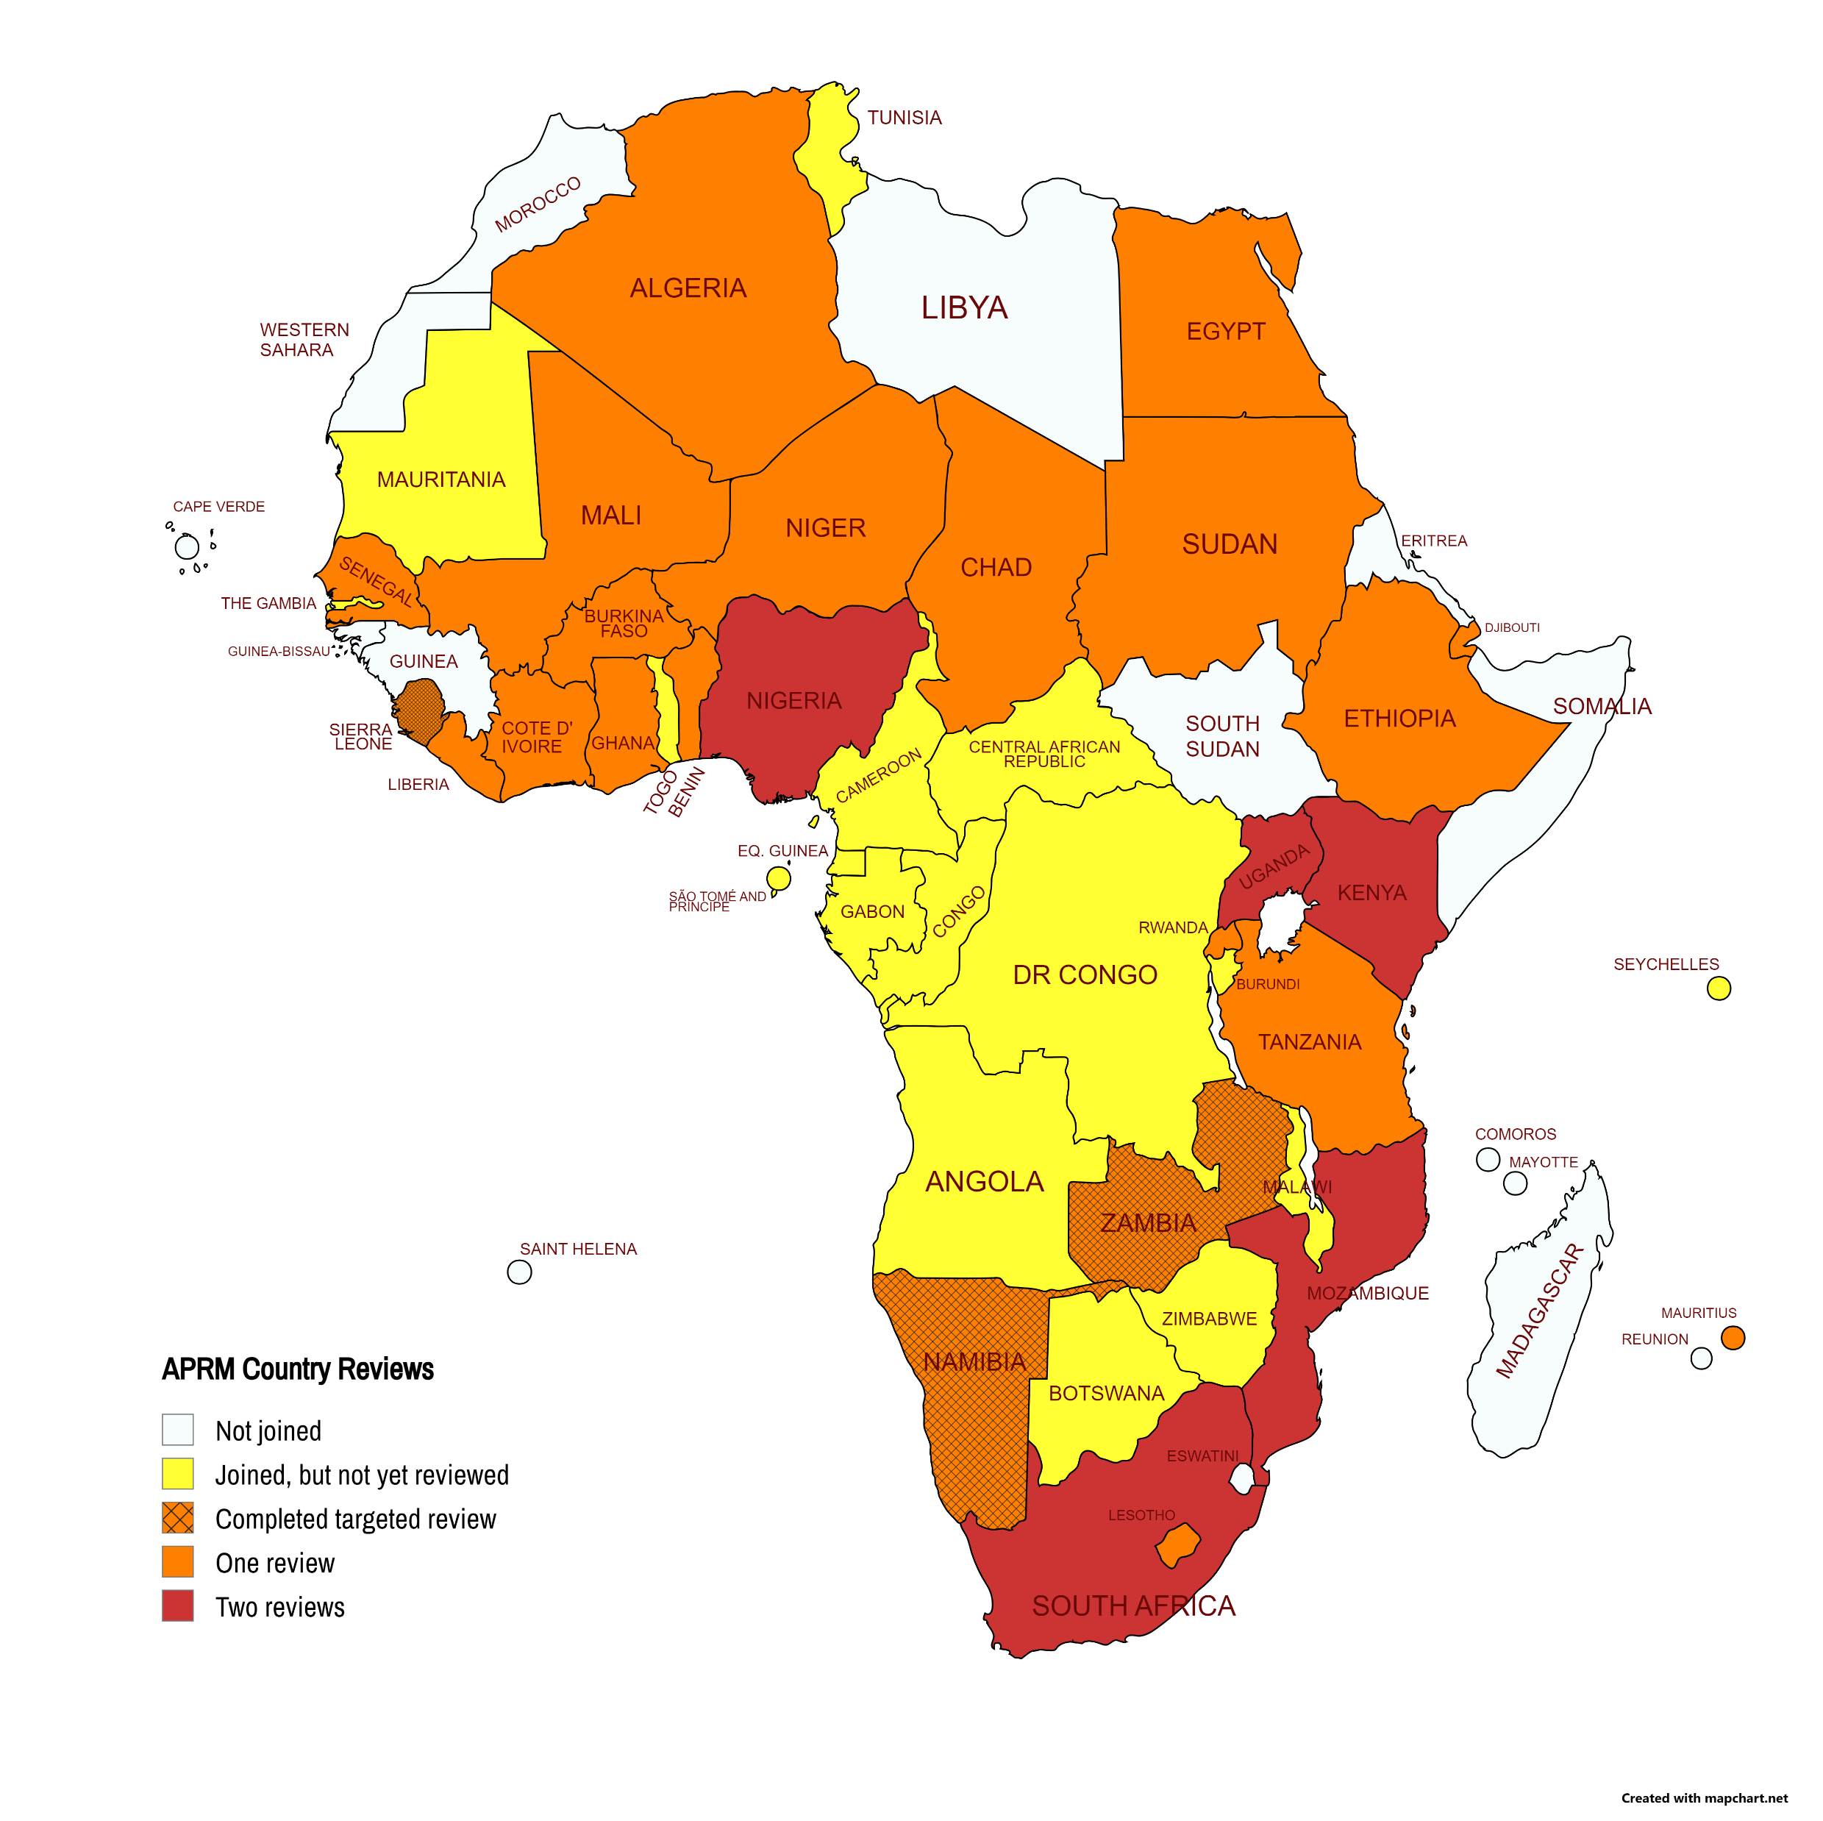
aprm statUs
2ND review completed
1st review completed
New or slow
Not in APRM
40/55 African states
22+3 reviewed
3 Targeted Reviews
Universal Accession by 2023

Slide 7
First 26+6+6 reviews
2006: Ghana, Rwanda, Kenya
2007: South Africa, Algeria
2008: Benin, Uganda, Nigeria, Burkina Faso
2009: Mali, Mozambique, Lesotho
2010: Mauritius
2011: Ethiopia
2012: Sierra Leone
2013: Zambia, Tanzania
2017: Chad, Djibouti, Senegal, Kenya II
2018: Sudan, Uganda II
2019: Côte d’Ivoire, Mozambique II
2020: Egypt, TRs of Djibouti, Namibia2021: Liberia, TR of Zambia, Sierra Leone
2022: Namibia, South Africa II, Nigeria II, TR Kenya
2023: Niger, special TR UCGs – Chad, Comoros, Djibouti, Lesotho, SL, Sudan

Slide 8
APRM in Malawi – opportunity to influence
Acceded in 2004 – not much has happened
Institutions, personnel and plans can be influenced
Government commitment waned, but focal point is in the Ministry of Finance – rejuvenation? Review by 2025?
Key challenges include poverty, inequality, unemployment, environment, corruption, state capture, SOE management
Build on SAIIA experience to train & empower civil society and parliamentarians – model used in Namibia, SA, Zambia, Tanzania, Lesotho, Uganda, Malawi, Zimbabwe, Botswana, Tanzania
Develop a written submission by APRM CSO Working Group

Slide 9
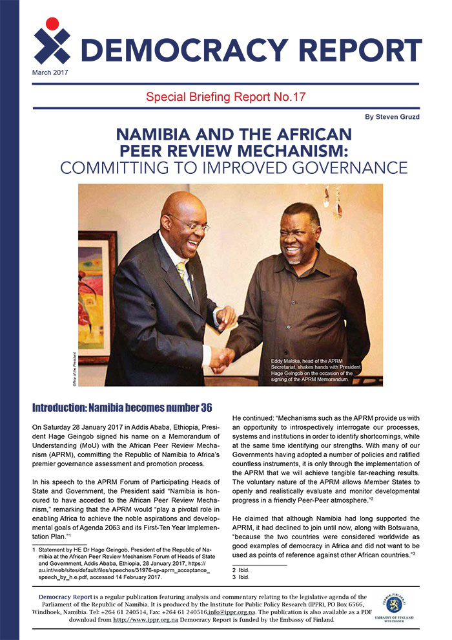
Malawi APRM Popular Sensitisation Project (MAPS)
Support for civil society and official process
Work with anchor partner: MEJN, APRM Secretariat, govt
Sensitisation workshop with experience sharing
Form an APRM CSO Working Group
Select & write up key issues in the MAPS submission
Validation
Launch
Dissemination strategy
Funder is SIDA

Slide 10
MALAWI AND THE APRM
2004
2022
2022-24
Malawi acceded to the APRM
President Chakwera prepared Malawi for self-assessment and peer review
SAIIA, MEJN & Malawi CSOs sensitization MAPS

Slide 11
KEY ISSUES FROM
THE MAPS SUBMISSION, 2024

Slide 12
Youth underemployment rate 77.5%
despite high national economic growth rates - not pro-poor growth
47% youth terminated education early for economic reasons
43.2% of Malawians are between 0-14 years
Gini co-efficient grown from 0.4 (2004) - 0.5 (2011)
‘least developed country’
SOCIO-ECONOMIC CONTEXT
50.74 %(2019) lived below national poverty line
TAVETA only able to process 1% of applications per year
73% of population live under international poverty line ($1.9 per day)

Slide 13
POLITICAL AND ELECTORAL GOVERNANCE
The Malawian Government should implement electoral reforms to provide adequate funding to operations of the MEC and increase support for voter civic education
Political parties should expand spaces for inclusivity
Political parties should strengthen platforms for dialogue with other political parties and electoral stakeholders
Political parties should establish mechanisms for strengthening their financial transparency and accountability
Political parties should hold more regular internal meetings of management bodies
Political parties should strengthen linkages between party manifestos and Malawi’s overarching development agenda
“Malawi has found electoral democracy comes with problems and has over the past three decades instituted reforms to address them”
Re-run of 2019 election – independent judiciary. Modifications to FPTP and 50%+1
Even after 2019 electoral reforms, issues remain such as voter apathy and fatigue, losing faith in democracy, election intimidation, lack of accountability regarding party funds, elite capture, tribal politics and nepotism, undemocratic party practices, family dynasties, transparency in party funding

Slide 14
The Malawian Government should provide adequate financing and technical support for governance and human rights institutions
The Malawian Government should ensure access to justice
The Malawian Government should provide vulnerable citizens with basic social benefits and functional facilities
The Malawian Government should ensure respect for the principles of separation of power
Civil society should assist in raising awareness and empowering citizens
All stakeholders should promote enhanced participation in national and international commemorations and simplify, popularize and translate important documents to local or vernacular languages and conduct civic education
HUMAN RIGHTS
Human rights are at the heart of Malawi’s democratic regime & post-1994 constitution
Although legislated, human rights protection remains concerning
There have been political killings, torture, undignified prison and detention centre conditions, pre-trial detentions and arbitrary arrests, capital punishment (finally outlawed), intimidation of refugees and asylum seekers, limited freedom of expression, threats to journalists, peaceful assembly and association, civic space
Not just civil and political rights – also socio-economic and cultural rights, eg development
Many unaware of rights and state’s duty
Several conventions not adopted on HRS
Imbalance of power
LGBTI practices criminalised

Slide 15
ACCESS TO INFORMATION
The Malawian Government should promote policies that facilitate access to information
The Malawian government should capacitate the MHRC to ensure that it has necessary resources
The Malawian government should improve the availability of data through the Open Data
The Malawian government should allocate sufficient resources to implementation and access to information law an policies and ensure effective monitoring of compliance
Civil society should collaborate, advocate and monitor the effective implementation of access to information act
Civil society assist in improving access to information for marginalised groups
Lack of awareness and education about the right to access information is a significant challenge in Malawi
There have been challenges in implementing the Access to Information Act
Limited oversight by MHRC
ATI critical to democracy and HRs
Govt unresponsive or classifies info
Journalists and citizens need more awareness and training

Slide 16
CORRUPTION
The Malawian Government should commit to full implementation of the access to information act
The Malawian government should provide sufficient resources and political support to ACB and expedite the process towards developing standalone law for whistle blower protection
The Malawian government expedite the process towards developing regulations for management of recovered assets, including the use of the Confiscation Fund;
The Malawian government should cut red tape and enforcement of applicable laws to deal with corruption and strengthen monitoring and performance management systems in public institutions
Civil society should promote ethical conduct among all stakeholders, whether in the state, the private sector or among private citizens;
Civil society should strengthen multi-stakeholder initiatives to deal with corruption and foster probity in particular sectors
2013 ‘Cashgate scandal’ exposed the weaknesses in public finance management
growing perception that corruption remains high and anti-corruption efforts have been somewhat ineffective
Between 2009 and 2014, the country is estimated to have lost around $723 million to fraud and corruption. Malawi is estimated to lose some 30% of public funds in its annual budget to corruption
CPI score of 34 – 115th positions
Police seen as most corrupt
COVID corruption cost billions
Clientelism and patronage in public service
ACB lacks funds and independence
Construction Sector Transparency (CoST) initiative, OGP, EITI
Complex and cumbersome procedures; Lack of a culture to hold duty-bearers accountable; Informal networks that promote nepotism and favouritism;
Institutional gaps; Capacity challenges in law enforcement agencies; resources; Weak coordination between agencies; Political Will?

Slide 17
SOCIAL PROTECTION
The Malawian Government should institute a strengthened, people-centred early warning system to enhance disaster management, planning and response;
The Malawian government should enhance official preparedness for response to and recovery from disasters
The Malawian government establish the National Old Age Social Pension Programme and Develop the National Old Age Social Pension Programme Implementation strategy.
Civil society should work to improve the resilience of communities to disasters
Malawi confronts regular disasters that disrupt people’s livelihoods, endanger human and food security, damage infrastructure and hinder socio-economic growth and development and more support must be given to ultra-poor populations for their livelihoods, when they are faced with threats.
Poverty in rural areas are much higher than in urban areas although an increase in urban poverty has been recorded throughout 2017 – 2020.
Climate change is presenting a new threat to social protection and requires additional social protection measures to be implemented.
The report finds that the challenges related to social protection experienced in the country are beyond what government can respond to by itself. Greater cooperation from the private sector is required.

Slide 18
EDUCATION
The Malawian Government should increase budgetary allocation to education to be in line with the international benchmarks of 6% of GDP and 20% of the national budget;
The Malawian government should explore innovative funding mechanisms
The Malawian government should increase funding available for secondary school bursaries
The Malawian government should develop a roadmap for implementing compulsory education
Civil society should conduct advocacy to ensure that government adequately implements provisions in the national adult literacy policy and strategic framework; and
Civil society should undertake research to establish factors causing poor performance by some districts
Malawi has experienced significant problems with the implementation of compulsory education (primary school).
The country also experiences a low secondary school completion rate.
Several barriers to access exist for children with disabilities.
Although the adult literacy rate is low, implementation of adult literacy programmes is not up to par.
Teachers experience several challenges related to the number of learners they are expected to manage (there is a benchmark of 1 teacher to 40 students but in 2021 this measured at 1:62 in Malawi). The country experiences a shortage of teachers which puts strain on the education system.

Slide 19
The Malawian Government should adhere to the Abuja Declaration of allocating 15% threshold to resource the health sector and improve its capacity;
The Malawian government should draw up a resource mobilisation plan, enhance its procurement system and strengthen institutional arrangement for health financing;
The Malawian government should prioritise the health needs of the youth though implementation of a National Youth Friendly Health Services Strategy
The Malawian government should ensure that health infrastructure reaches underserved areas
Development partners should adhere to the Paris Declaration and other relevant frameworks to make aid predictable, and streamed through the Government system or linked to the support of existing instruments in the sector.
Civil society should work to strengthen accountability systems
HEALTH
Understaffing in the health sector is a major hurdle. In addition, there is no real coordination between the various institutions within the health sector, thereby compromising effectiveness. This speaks to weakness of the governance structures within the health sector.
Because of understaffing and lack of coordination, capacity within the health sector is limited. This has been especially evident during natural disasters and more recently during the pandemic.
The sector also experiences a series of financial challenges, especially in terms of per capita expenditure and financing, as well as criminal exploitation.

Slide 20
EMPLOYMENT
The Malawian Government should review existing legislation.
The Malawian government should prioritise areas that offer significant payoffs for the prospects of Malawi’s youth
The Malawian government should involve the youth in planning policies for their own benefit;
The Malawian government should promote development of technical and vocational skills for the youth
The Malawian government should implement unfulfilled election promises, in particular creating one million jobs for youth graduates and young women with tertiary and secondary school qualifications
Civil society should advocate for the rights of youth and youth employment
The government of Malawi has made the commitment to create 1 million jobs
The main barriers to employment are identified as lack of education and appropriate skills and capital, a lack of experience, as well as the basic absence of opportunities in the labour market.
Youth unemployment is a particular concern. The youth unemployment rate spiked significantly during the pandemic. Apart from unemployment, the report also identified underemployment as a risk to the country’s youth, with many of this group being stuck in the informal sector. This also has a gendered component, and the report finds that more men are employed in the informal sector with young women often being forced into early marriage and sex work.

Slide 21
CLIMATE GOVERNANCE
The Malawian Government should strengthen the institutional and legal framework for environmental protection and management.
The Malawian government should enhance the capacity of the institutions coordinating climate change and environment programmes
The Malawian government should operationalise the EAT as it will provide a platform for improving access to environmental justice and enhance environmental rule of law
The Malawian government should combat environmental degradation
The Malawian government should radically improve waste management
Civil society should Set up a joint coordination mechanism among various key stakeholders to manage environmental risks
Environmental governance is central to Malawi’s economic development prospects which is largely dependent on natural resources.
Malawi’s government has embraced policy solutions for improving the state of environmental governance.
Climate change is a real threat and the report notes that Malawi is vulnerable to floods and droughts, as well as tropical cyclones.
The country is heavily dependent on agriculture and climate change affects this sector significantly. Crop and livestock production are heavily impacted, which in turn affects people’s livelihoods.
Floods and droughts have periodically been experienced, but because of the climate emergency these are becoming more intense.

Slide 22
THANK YOU
EMAIL
steven.gruzd@saiia.org.za
SAIIA APRM TOOLKIT
https://www.aprmtoolkit.saiia.org.za/

