Slide 1
THE African Peer Review Mechanism in brief and why it matters
An introduction to the Malawi APRM Popular Sensitisation (MAPS) Project
Sunbird capital hotel
Lilongwe
Steven Gruzd
4 APRIL 2024

Slide 2
Outline
SAIIA and the APRM
APRM explained
MAPS: APRM in Malawi – an opportunity to influence
Way forward

Slide 3
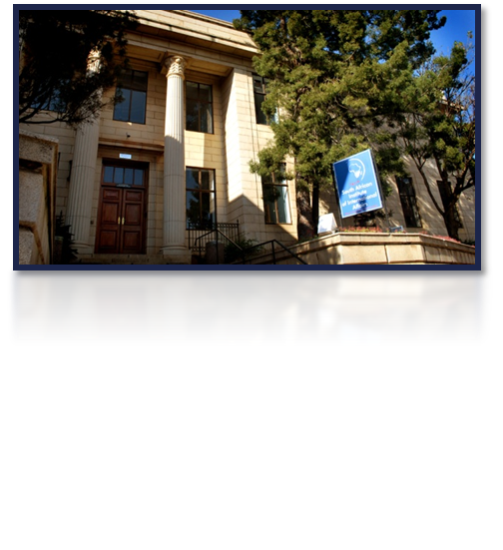
SAIIA and THE APRM
Since 1934, independent, non-governmental think tank on international affairs. Turned 90 in 2024
5 major programmes: AGDP, EDIP, CNRP, Futures, Youth
Worked consistently on APRM since 2002
Research, analysis, training, consulting to the Secretariat
Sensitised CSOs in early countries, worked on questionnaire revision, bottlenecks to development, expanded mandate, analysis of reports, media
Developed CSO submissions in Namibia, Botswana, SA, Zimbabwe and Lesotho 2018-22

Slide 4
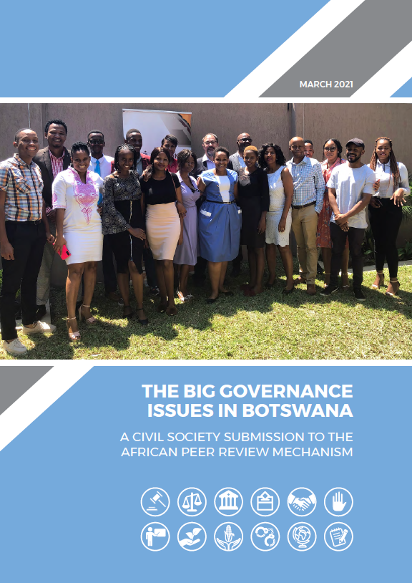
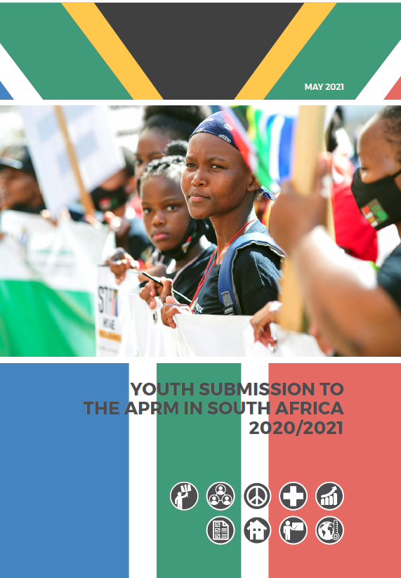
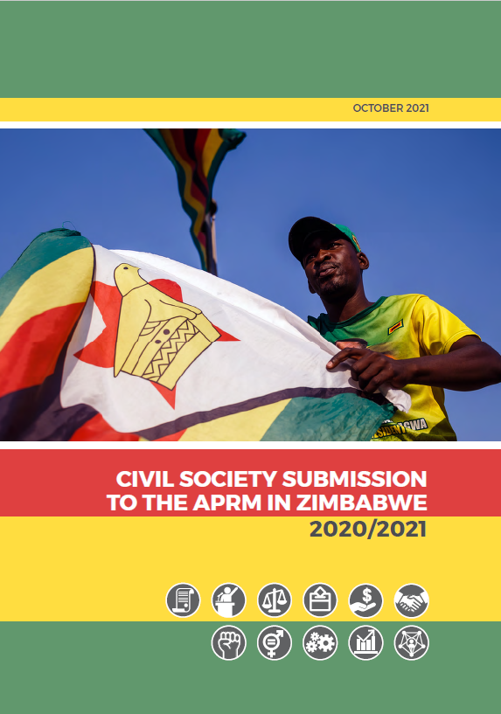
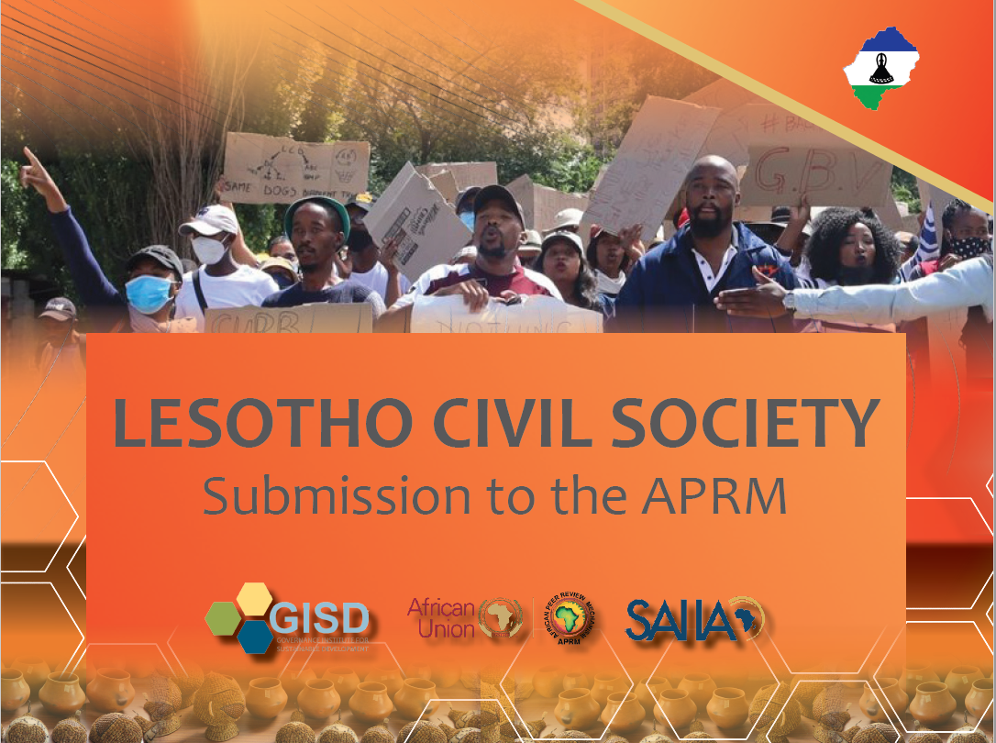

Slide 5
APRM in a nutshell
Africa’s voluntary governance review and promotion tool established in 2003, grew out of NEPAD
Belief that dialogue, peer pressure, diplomacy & civil society involvement can catalyse and support reform
Measures adherence to African & global standards in 5 thematic areas, comprehensive, based on questionnaire
“Technically competent, credible, and free of political manipulation”
Set up institutions at national and continental level
Self-assessment, country review mission, peer review
Develop, fund, implement and report on NPoA
44/55 African states, 27+6+5 reviewed

Slide 6
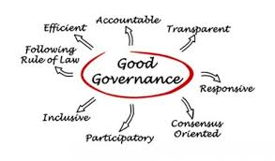
APRM: THE BASICS
Based on 105 page Questionnaire (Revised in 2012), self-assessment needs varied research & consultation methods
Covers almost every governance theme – choose!
Envisaged as a continuous process, not a one-off
Supposed to be a country-wide process, not just a government one. Thus, participation of civil society, academia, business, parliament is very important – on NGC, but also making written submissions

Slide 7
First 27+6+5 reviews
2006: Ghana, Rwanda, Kenya
2007: South Africa, Algeria
2008: Benin, Uganda, Nigeria, Burkina Faso
2009: Mali, Mozambique, Lesotho
2010: Mauritius
2011: Ethiopia
2012: Sierra Leone
2013: Zambia, Tanzania
2017: Chad, Djibouti, Senegal, Kenya II
2018: Sudan, Uganda II
2019: Côte d’Ivoire, Mozambique II
2020: Egypt, TRs Namibia2021: Liberia, TR of Zambia, Sierra Leone
2022: Namibia, South Africa II, Nigeria II, TR Kenya
2023: Niger, TR Djibouti, UGC AGR 2024: Namibia

Slide 8
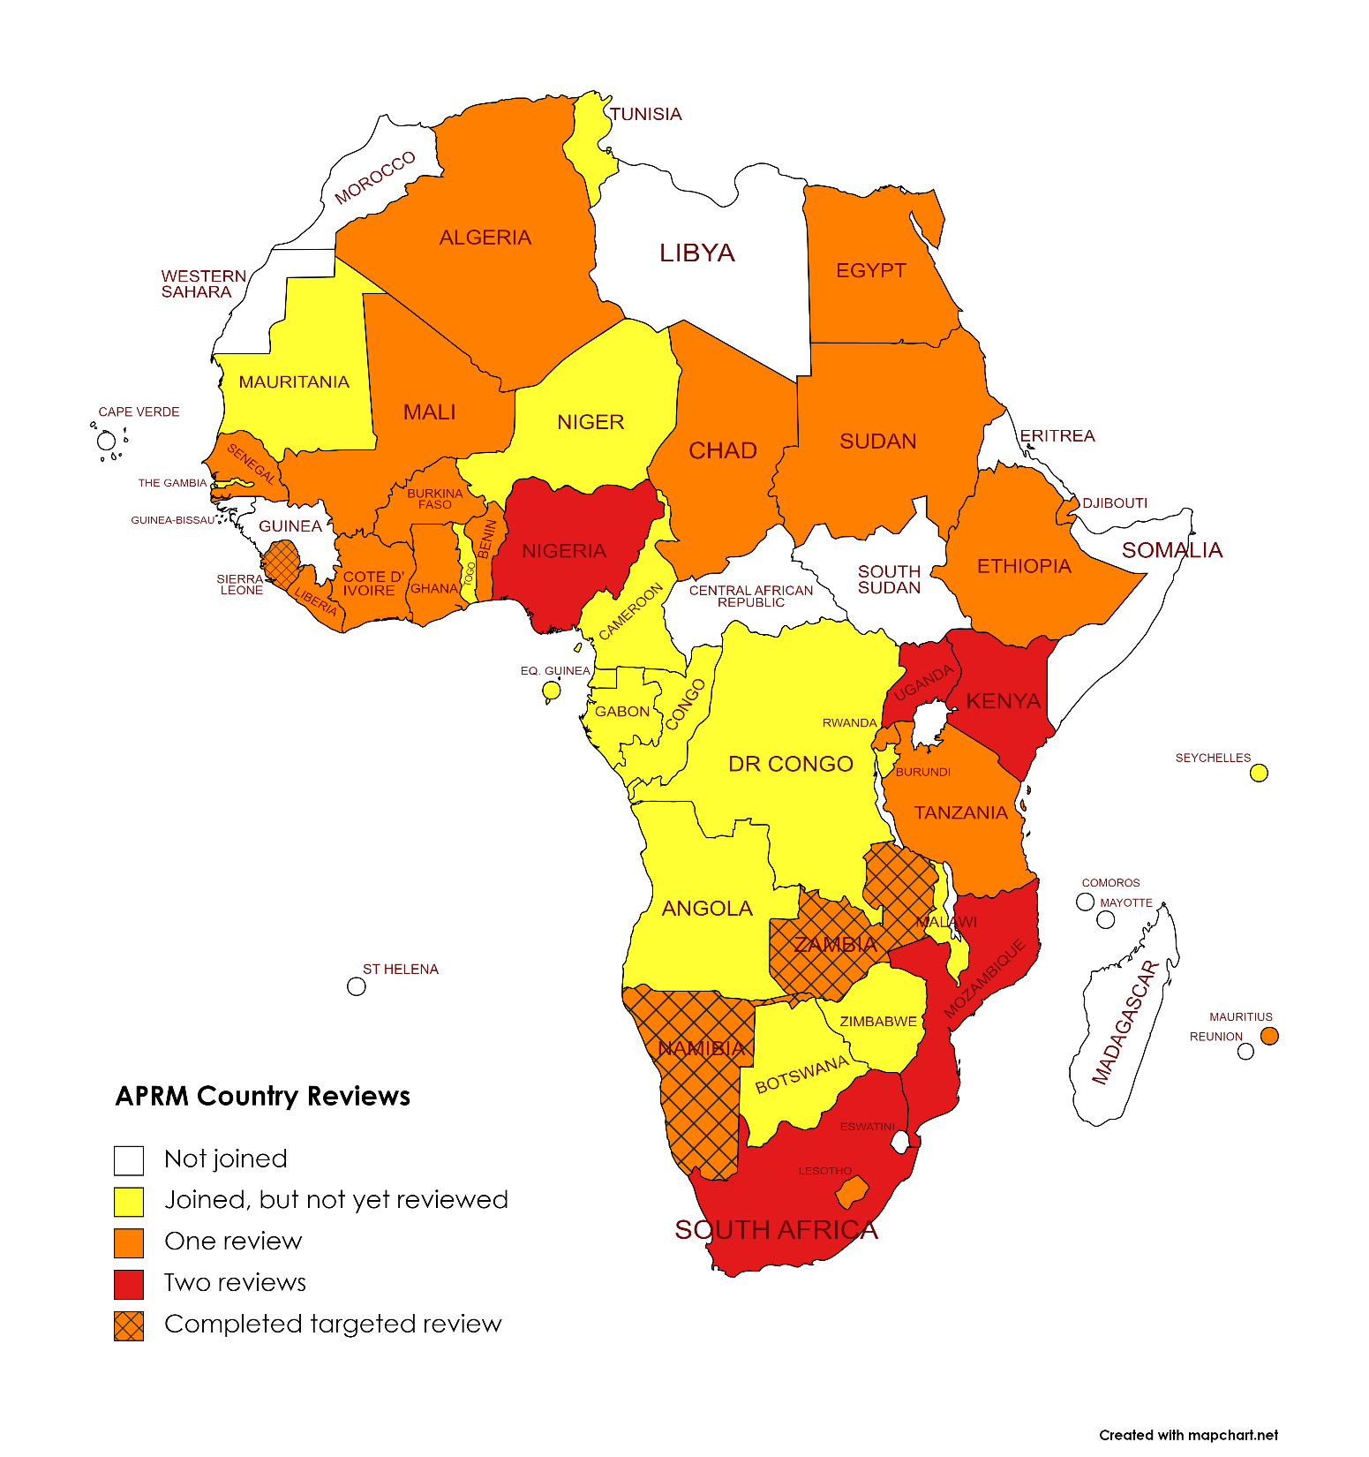
aprm statUs
2ND review completed
1st review completed
New or slow
Not in APRM
40/55 African states
22+3 reviewed
3 Targeted Reviews
Universal Accession by 2023

Slide 9
Challenges
“Peers”? Countries with different political outlooks/ levels of development, varying political commitment
Logistics, support, financing, stamina, M&E
CSOs: interested but have difficulty making meaningful input
Media: shown modest interest – process is highly technical
Time: multi-year process for most countries
Implementation of NPoAs
Has it worked? Ibrahim Index - governance has flatlined Leadership, domestic or external reasons, and funding

Slide 10
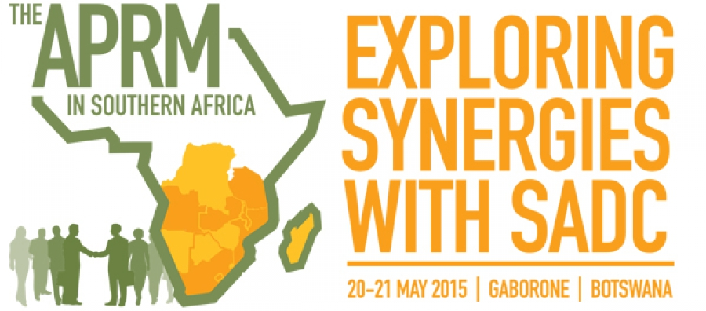
APRM in SADC: growing membership
6 reviewed: South Africa (2007, 2022), Lesotho (2009), Mozambique (2009, 2019), Mauritius (2010), Zambia (2013) & Tanzania (2013), Namibia (2022 & 2024)
2 very slow: Malawi & Angola (joined 2004)
5 newly joined: Namibia (2017), Botswana (2019), Zimbabwe (2020), Seychelles (2020), DRC (2022)
2 not joined: Madagascar, eSwatini

Slide 11
KEY issues in SADC CRRS
Reports predicted xenophobia in SA, tensions in Mozambique, constitutional crisis in Zambia
Managing diversity, electoral systems, separation of powers, corruption, public finance management
Land, poverty, unemployment, education, health
Inclusion of civil society crucial but contested
Good diagnosis, locally rooted, but NPoAs poor
Little evidence of peer pressure

Slide 12
APRM in Malawi – opportunity to influence
Acceded in 2004 – nothing much done since!
Institutions, personnel and plans can be influenced
Government commitment waned, but focal point is Ministry of Finance and Economic Affairs, Hon MP – rejuvenation?
Key challenges include poverty, inequality, unemployment, environment, corruption, state capture, SOE management
Build on SAIIA experience to train & empower civil society and parliamentarians – model used in Namibia, SA, Zambia, Tanzania, Lesotho, Uganda, Zimbabwe and Botswana
Develop a written submission by APRM CSO Working Group

Slide 13
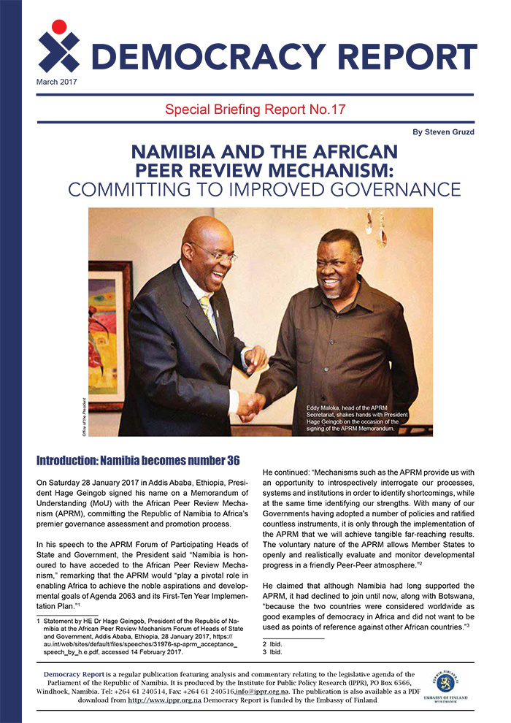
MALAWI APRM popular Sensitisation (MAPS) project
Support for civil society and official process
Work with anchor partner: MEJN, APRM Secretariat, govt?
Sensitisation workshop with experience sharing
Formed an APRM CSO Working Group
Select & write up 9 key issues in the MAPS submission
Validation – 4 April 2024
Dissemination strategy
Funder is SIDA

Slide 14
Benefits for MALAWI and the region
Comprehensive governance assessment, by Africa
Identify strengths, weaknesses, remedies
Opportunity for CSOs to co-create in a positive way
Share best practices
Opens civil space, platform to raise pertinent issues
Attract investment and improve national brand?
Encourage others to accede
Strengthen SADC as more countries deal with cross-boundary issues – climate, health, migration

Slide 15
MAPS Provisional timetable for 2022-24
Anchor Partner Selection (MEJN): September 2022
Pre-Planning Meeting: October 2022
Sensitisation Workshop: December 2022
Working Group Meeting select issues, background paper commissioned: December 2022
Working Group Meetings November to April 2023
Validation: April 2024
Launch: 30 June 2024

Slide 16
Thank you!
Steven.Gruzd@saiia.org.za
@rhymeswbruised #EngageAPRM on Facebook

